Slide 1


Analytical squad
KIVA LOANS
PROJECT
May 2024

Slide 2

CONTENT
01
Dataset Description
02
Objectives
03
Answering questions
04
Time series
05
Model
06
Evaluation

Slide 3
We aim to analyze a dataset containing information about loans provided by a Kiva organization. The dataset consists of various attributes related to each loan. Download Dataset: Kiva Loans
OVERVIEW
1. id: Unique identifier for each loan.
2. Funded_amount: The amount of money funded for the loan.
3. Loan_amount: The total amount of money requested for the loan
4. Sector: The sector for which the loan is intended (e.g., Food, Transportation).
5. Country: The country where the loan is being provided.
6. Partner_id: Identifier for the partner organization facilitating the loan.
7. Term_in_months: The term of the loan in months.
8. Lender_count: The number of lenders contributing to the loan.
9. Borrower_genders: Genders of the borrowers (e.g., female, male).
10. Repayment_interval: The interval at which repayments are made (e.g., irregular, bullet).
11. Date: The date when the loan was initiated.

Slide 4



OBJECTIVES
Which sectors receive the highest amount of funding, and how does this change over time?
Is there a correlation between the number of lenders and the funded loan amount?
Can we predict future loan amounts based on historical data?

Slide 5
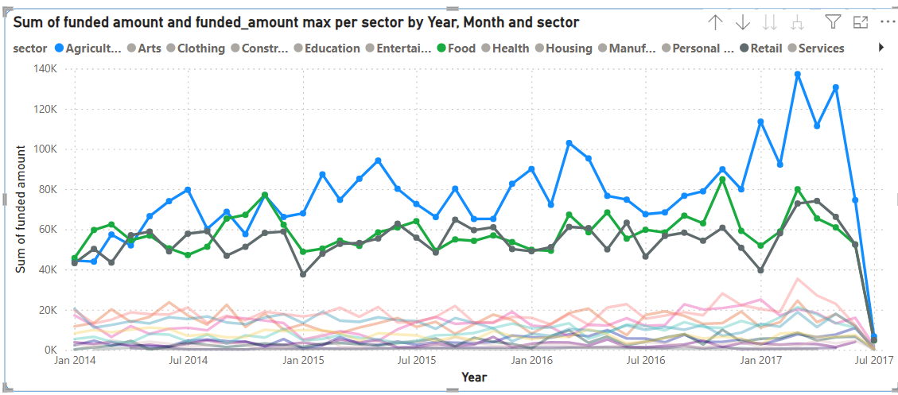
WHICH SECTORS RECEIVE THE HIGHEST AMOUNT OF FUNDING, AND HOW DOES THIS CHANGE OVER TIME?
1-Agriculture 2-Food 3-Retail

Slide 6
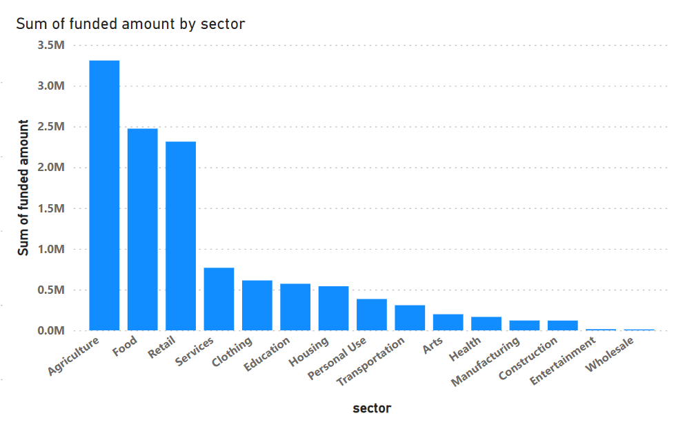
WHICH SECTORS RECEIVE THE HIGHEST AMOUNT OF FUNDING

Slide 7
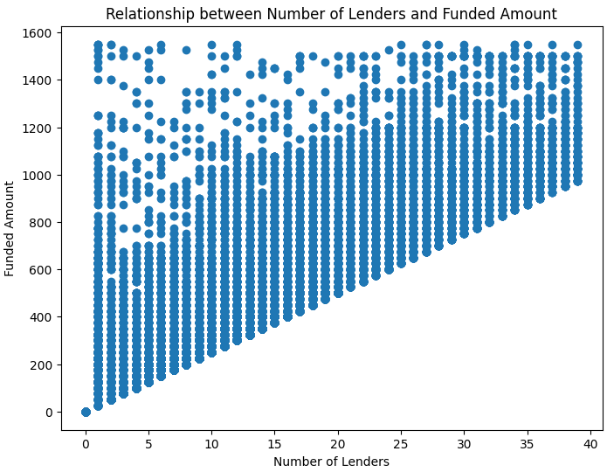
IS THERE A RELATION BETWEEN THE NUMBER OF LENDERS AND THE FUNDED LOAN AMOUNT?

Slide 8
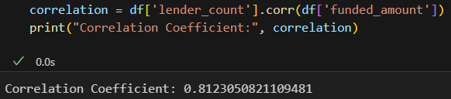
IS THERE A RELATION BETWEEN THE NUMBER OF LENDERS AND THE FUNDED LOAN AMOUNT?
STRONG POSITIVE CORRELATION

Slide 9
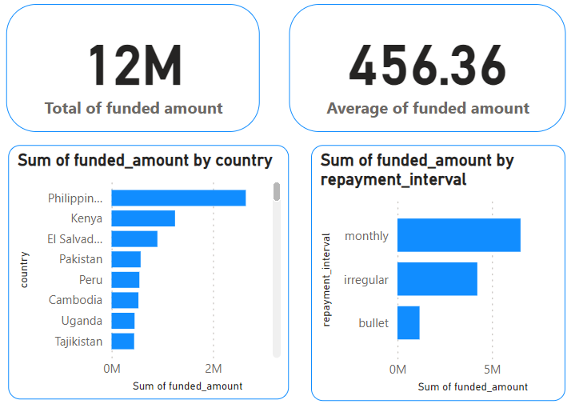
STATISTIC

Slide 10
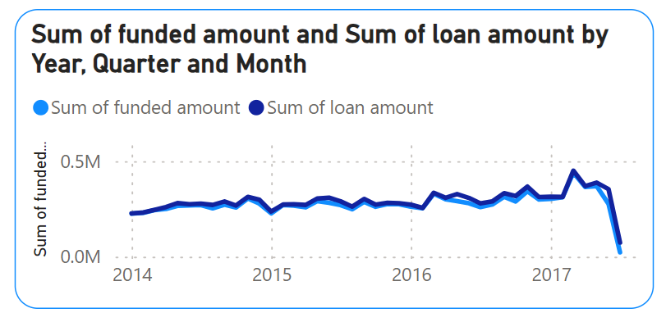
Relation between Funded amount and loan amount

Slide 11

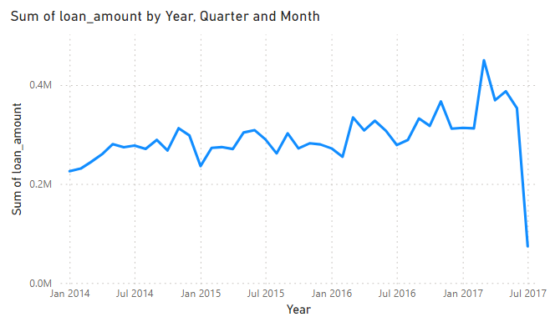
TIMELINE
2014
2015
2016
2017
2018??

Slide 12

CAN WE PREDICT FUTURE LOAN AMOUNTS BASED ON HISTORICAL DATA?
YES , WE CAN PREDICT BY USING TIME SERIES AND ARIMA MODEL

Slide 13
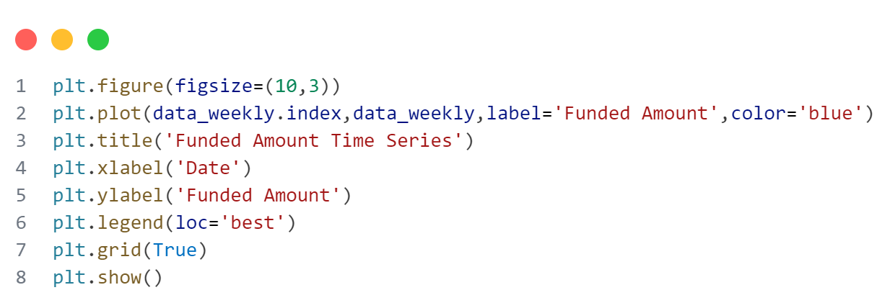
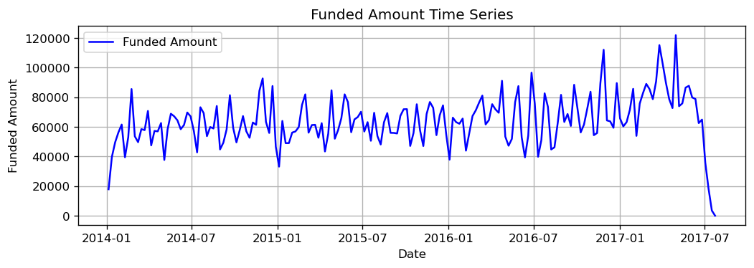
Funded Amount Time Series

Slide 14
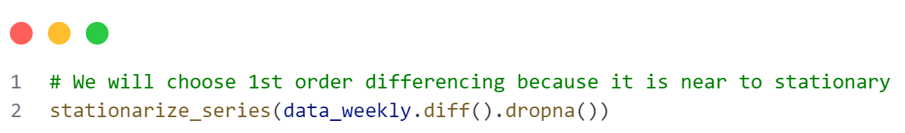
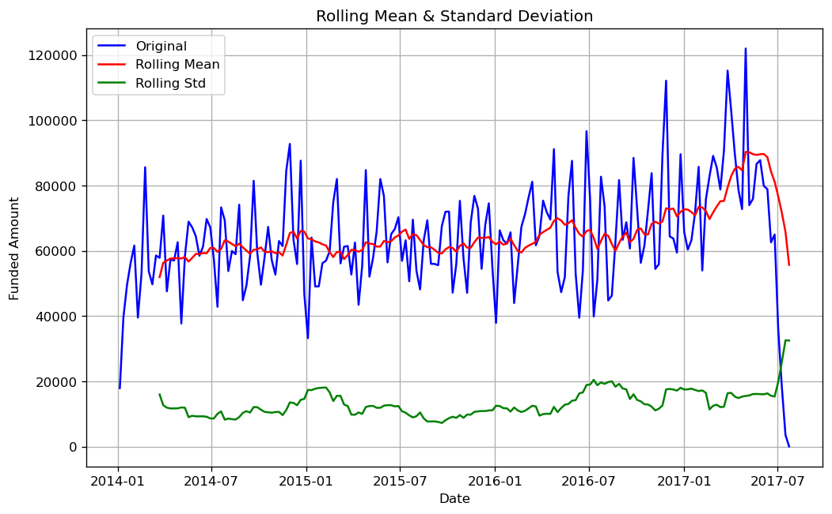
1st Order Rolling Mean & Standard Deviation

Slide 15
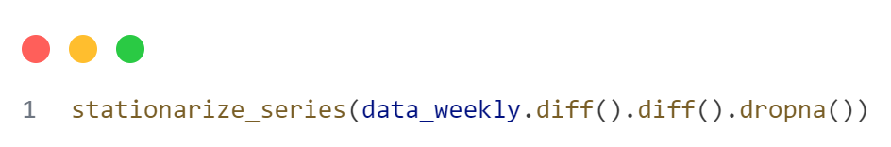
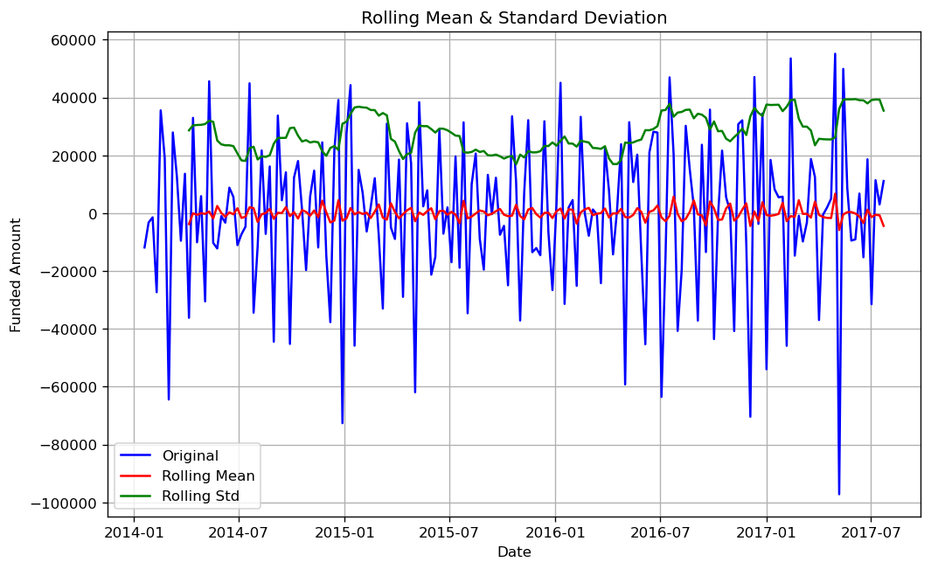
2nd Order Rolling Mean & Standard Deviation

Slide 16
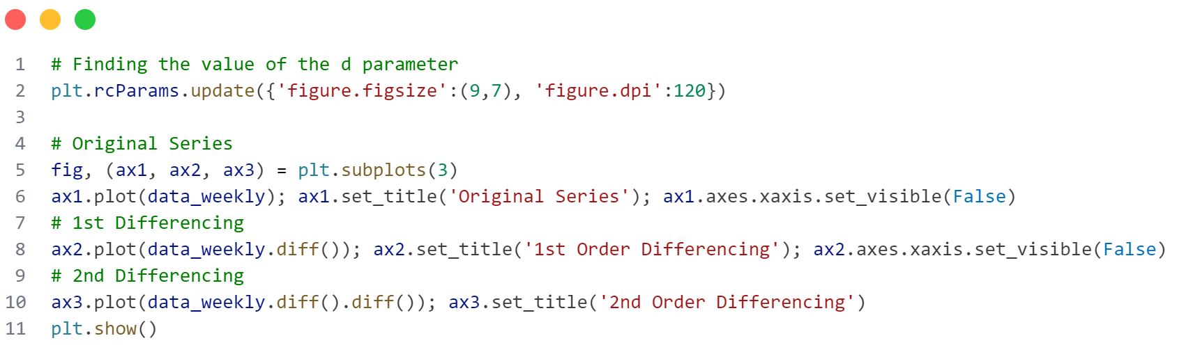
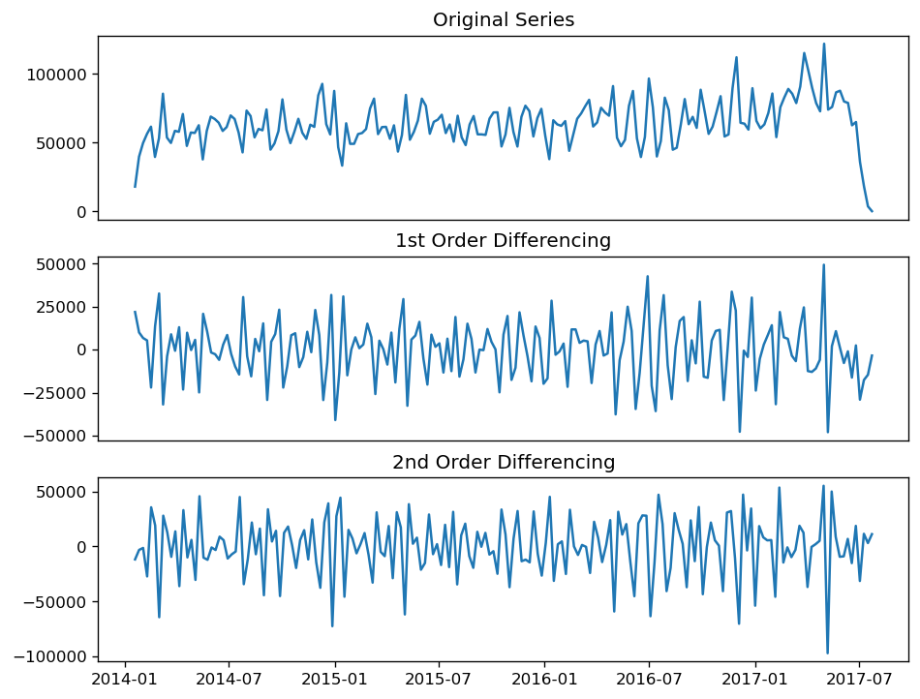
Differencing
to stationarize the series

Slide 17
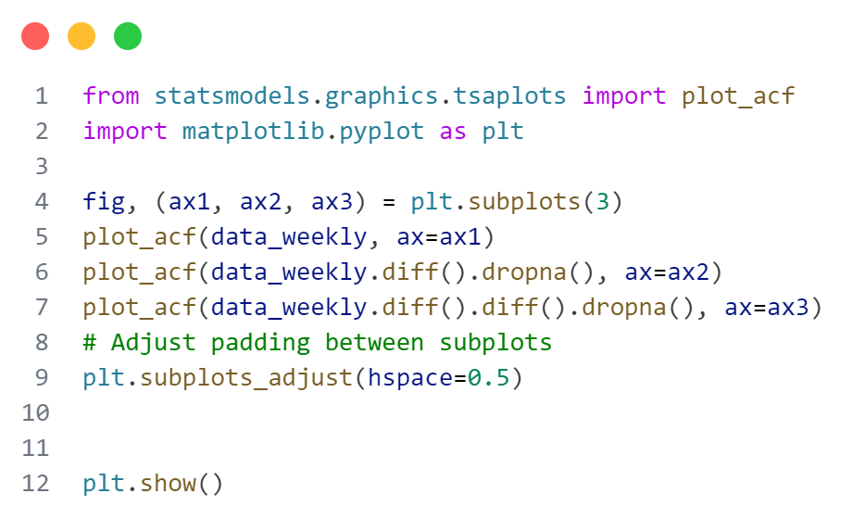
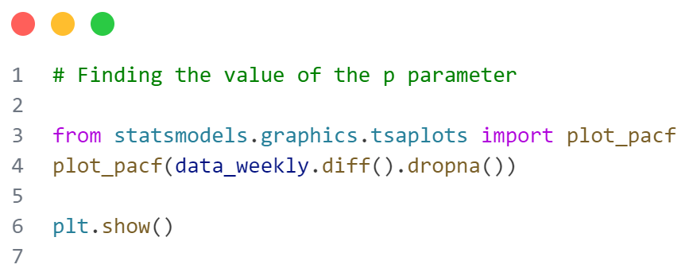
ACF , PACF
To Extract ARIMA Model Parameters

Slide 18
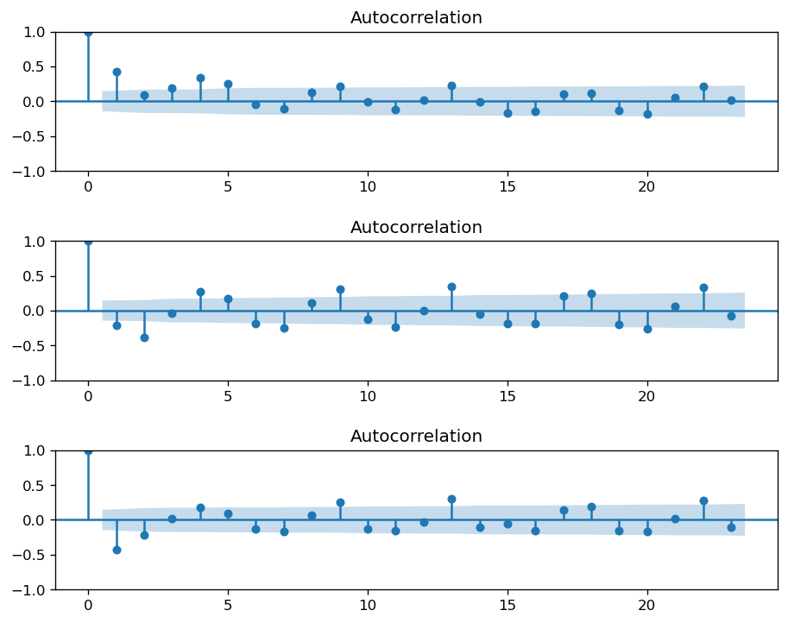
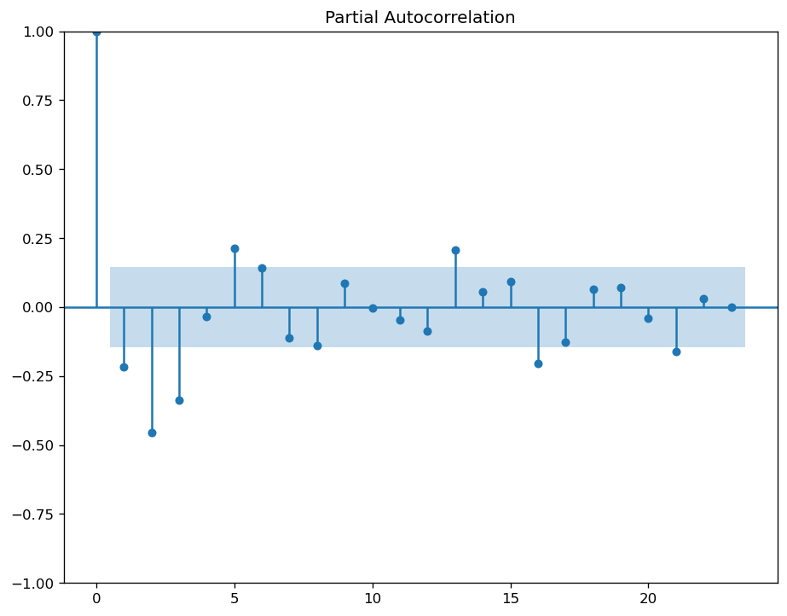
ACF , PACF
To Extract ARIMA Model Parameters

Slide 19
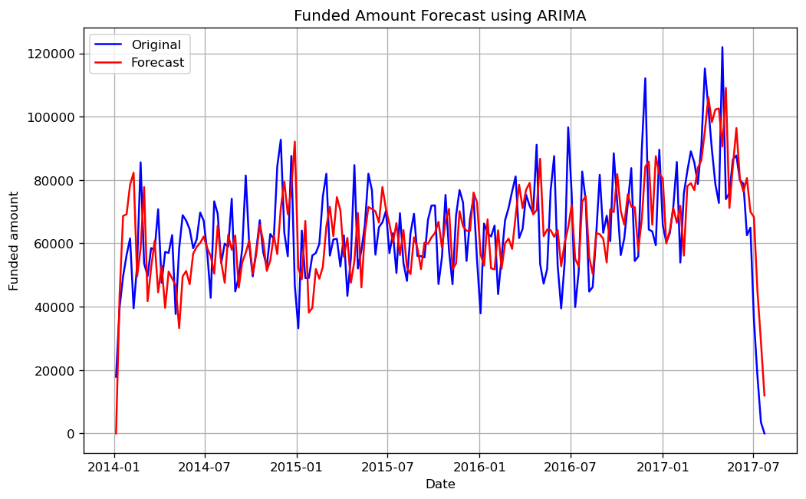
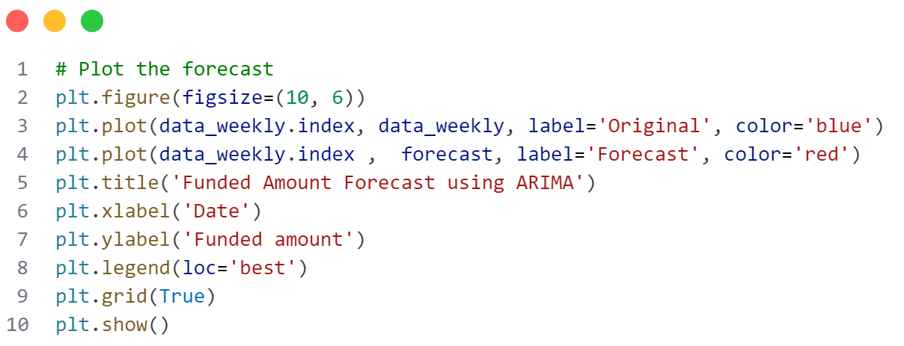
Funded Amount Forecast using Arima

Slide 20
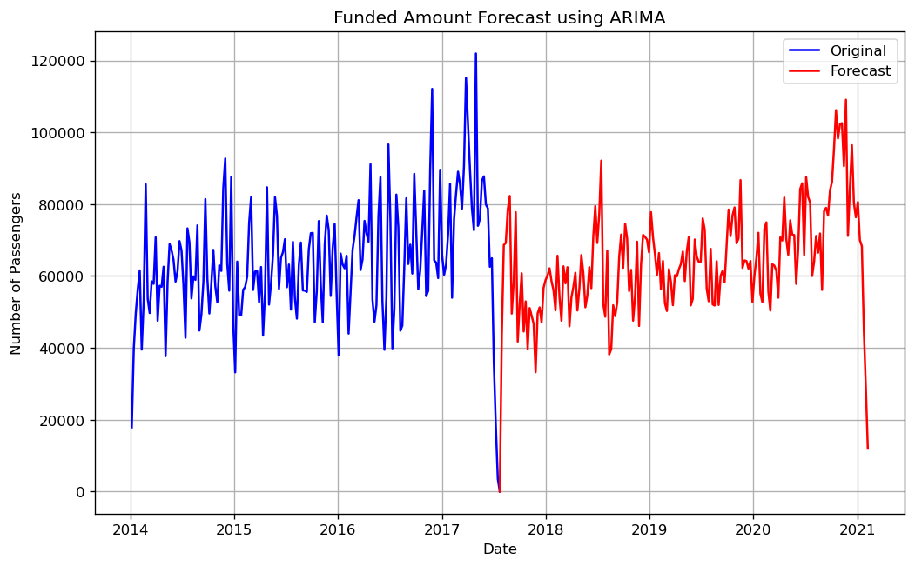
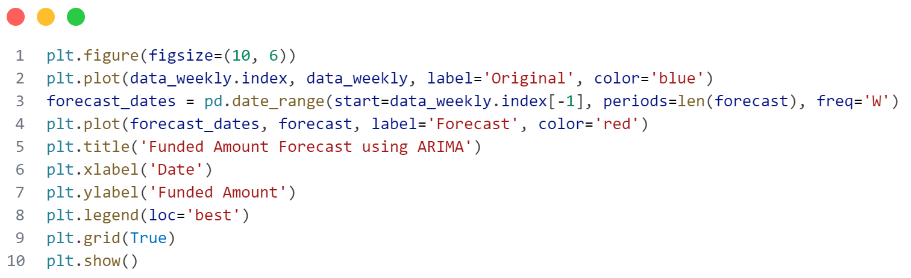
Funded Amount Forecast using Arima

Slide 21
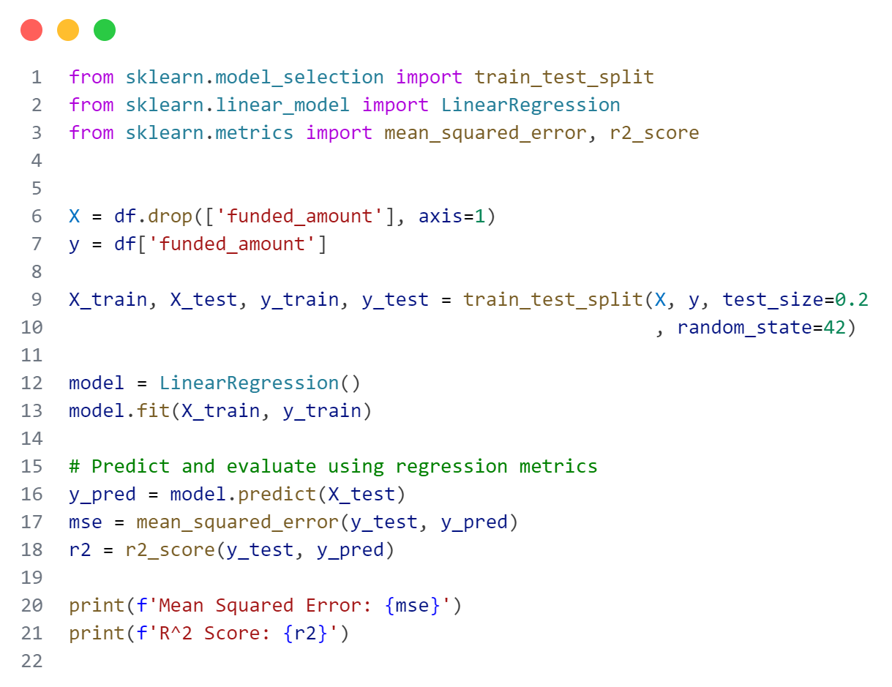
Linear Regression Model
Mean Squared Error: 8098.3827477937075 R^2 Score: 0.9084642368891588

Slide 22
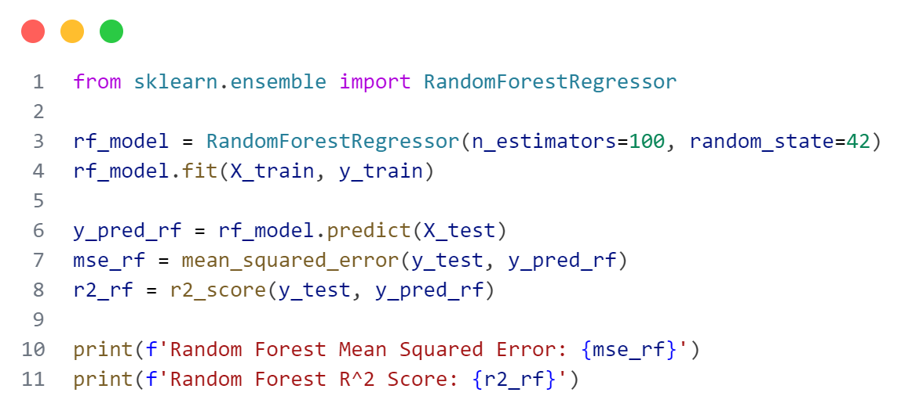
Random Forest Regression Model
Mean Squared Error: 4024.8233
R^2 Score:
0.95450754

Slide 23
Conclusion
The analysis of the Kiva loans dataset has provided valuable insights into the funding patterns and loan characteristics facilitated by the Kiva organization. By leveraging data exploration, visualization, and machine learning techniques, we have addressed key questions and objectives of this business intelligence project. Below are the key takeaways and conclusions:
- Sector Analysis:
We identified the sectors that receive the highest funding, with Agriculture, Food, and Retail being the top recipients. This information can help Kiva prioritize their resources and focus on sectors with high funding demands.
Over time, funding trends reveal shifts in sector priorities, indicating changes in economic needs or donor preferences.
- Correlation Analysis:
Our analysis demonstrated a significant correlation between the number of lenders and the funded loan amount. This suggests that larger loan requests attract more lenders, possibly due to the perceived impact or project scale.
- Predictive Modeling:
Using historical data, we developed a machine learning model to predict future loan amounts. The model achieved a high R² score of 0.908, indicating that it can accurately forecast loan amounts based on past trends and attributes.
This predictive capability can assist Kiva in anticipating funding needs and managing resources more effectively.
- Time Series Analysis:
By constructing a time series of the funded amounts, we observed seasonal and temporal patterns in loan funding. These insights can guide strategic planning and funding allocation throughout the year.

Slide 24

Analytical squad
THANK YOU
FOR YOUR ATTENTION
May 2024

